Slide 1
MUTATIONS

Slide 2
In biology, a mutation is an alteration of the nucleotide sequence of the genome of an organism
May occur in somatic cells (aren’t passed to offspring)
May occur in gametes (eggs & sperm) and be passed to offspring

Slide 3
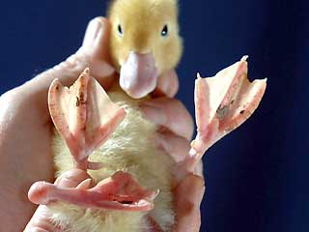
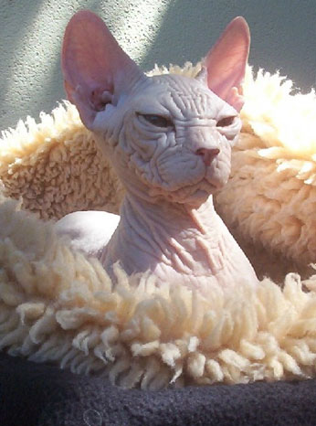
Mutations can:
- be bad, leading to cancer, aging, birth defects, self-aborted embryos

Slide 4
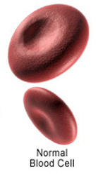
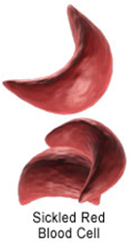
CACGTGGACTGAGGACTCCTC
Codon for CTC =
glutamate
CACGTGGACTGAGGACACCTC
Codon for CAC =
valine
What does it matter???

Slide 5
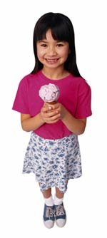
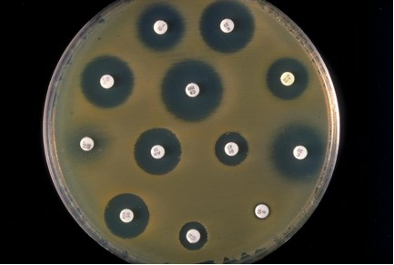
be good, making an organism survive better in its environment
Example: bacteria becoming antibiotic-resistant
The ability to drink milk as an adult is a helpful mutation.

Slide 6
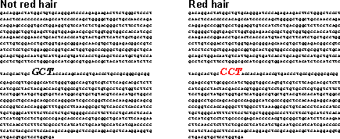

Slide 7
Types of Mutations

Slide 8
Gene Mutations
Change in the nucleotide sequence of a gene
May only involve a single nucleotide

Slide 9
Types of Gene Mutations
Point Mutations
Missense
Nonsense
Silent
Frameshift
Insertions
Deletions

Slide 10
Point Mutations
A point mutation or substitution is a genetic mutation where a single nucleotide base is changed.

Slide 11
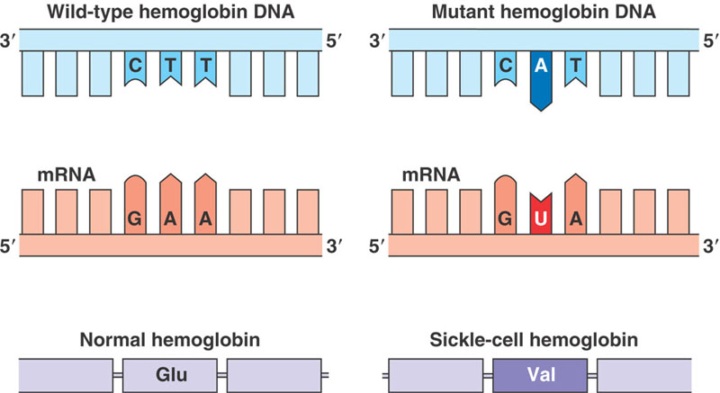
a. Missense Mutation
This type of mutation is a change in one DNA base pair that results in the substitution of one amino acid for another in the protein made by a gene. Example is Sickle cell anemia

Slide 12
b. Nonsense Mutation
A nonsense mutation is also a change in one DNA base pair. Instead of substituting one amino acid for another, however, the altered DNA sequence prematurely signals the cell to stop building a protein. This type of mutation results in a shortened protein that may function improperly or not at all. Examples include Duchenne Muscular Dystrophy and Thalassemia

Slide 13
Normal condition
DNA
5’ATG ACT CAC CGA GCG CGA AGC TGA3’
3’TAC TGA GTG GCT CGC GCT TCG ACT5’
mRNA
AUG ACU CAC CGA GCG CGA AGC UGA
Protein
Met Thr His Arg Ala Arg Ser Stop

Slide 14
Nonsense mutation
DNA
5’ATG ACT CAC TGA GCG CGA AGC TGA3’
3’TAC TGA GTG ACT CGC GCT TCG ACT5’
mRNA
AUG ACU CAC UGA GCG CGA AGC UGA
Protein
Met Thr His Stop

Slide 15
c. Silent Mutations
Silent mutations are mutations in DNA that do not have an observable effect on the organism's phenotype.
For example, if the codon AAA is altered to become AAG, the same amino acid – lysine – will be incorporated into the peptide chain

Slide 16
Frame Shift Mutations
1. Insertion Mutations
An insertion changes the number of DNA bases in a gene by adding a piece of DNA. As a result, the protein made by the gene may not function properly.
Example
UUU UUA UCU Phe-Leu-Ser
UUU UUA UUU UCU Phe-Leu-Phe-Ser

Slide 17
2. Deletion
A deletion changes the number of DNA bases by removing a piece of DNA. Small deletions may remove one or a few base pairs within a gene, while larger deletions can remove an entire gene or several neighboring genes. The deleted DNA may alter the function of the resulting protein(s).
UUU UUA UUU UCU Phe-Leu-Phe-Ser
UUU UUA UCU Phe-Leu-Ser

Slide 18
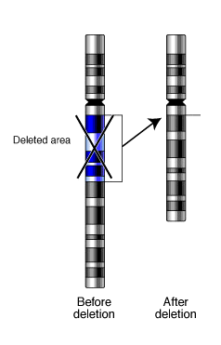
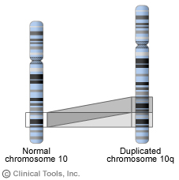
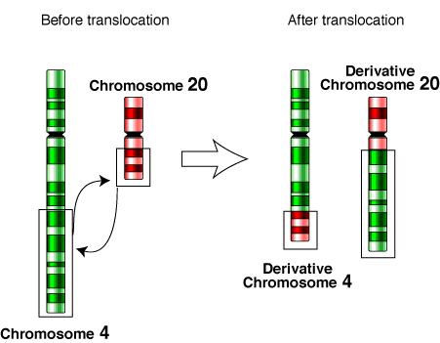
Types of Mutations
2. Chromosomal mutation – may affect more than one gene
Examples: nondisjunction, translocation

